Slide 1
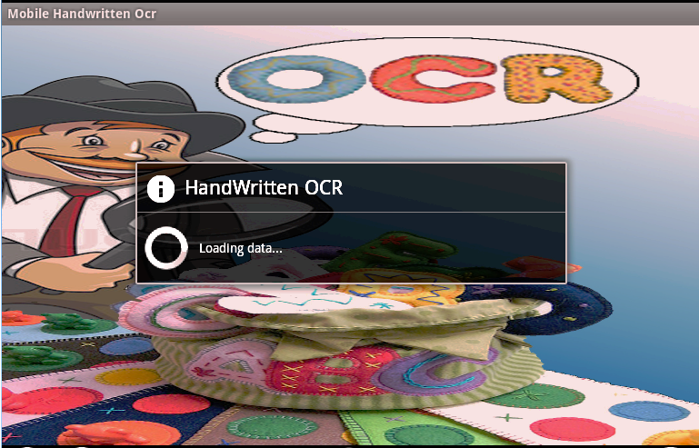
Mobile OCR for Handwritten Text Recognition

Slide 2
Group Members
Nouman Dilawar
Umair Muneer Butt
Uzma Ijaz
Supervisor:
Mr. Umar Suleman

Slide 3
Introduction
Implementing an OCR that works in all possible conditions with high accuracy is quite a challenge.
In this project we have developed a simple OCR for handwritten English characters and digits.

Slide 4
Problem Statement
The system can benefit the partially sighted people in reading short notices on the go.
It can be quite useful to extend the system to digitize the handwritten documents.
It can make users to Easily edit and store written text.

Slide 5
Outline
Motivation
Operating Environment
Project Scope
Use cases
Research Walkthrough
Design Methodology
System Architecture Diagram
Phases of OCR
Results and Demo
Conclusion

Slide 6
Motivation
The project has proved to be very beneficial for the project team in learning aspects. We have learned different image processing techniques. We will be having an exposure to different tools/technologies we have never used before.
Developing our interest in mobile development which is growing in software industry nowadays.

Slide 7
Operating Environment
Android SDK 3.x.x Honeycomb
Eclipse IDE
Open CV 2.3.1
JAVA
XML
Device
Android Virtual Devices
Blue Stacks App player
Android emulator
Samsung Galaxy SIII

Slide 8
Project Scope
The system will recognizes the discrete or clearly written joining/cursive handwritten letters and digits only.
The capturing angle of the text image should be between 60◦ to 120◦.
The camera resolution is proposed to be greater than “2 Mega pixels” for better results.
The system works under proper lightening conditions.

Slide 9
Use Cases
User can select the Text mode i.e Joining or discrete
The user can use an image that already exists in the gallery or he/she can capture a new image.
The user can crop the text region from the image to process it.
The user can manually adjust the threshold to remove the noise.
User can also listen to the corresponding voice after the text is recognized and displayed on the screen.

Slide 10
Research Walk Through
Research Papers and Surveys
What is OCR
Phases of OCR
Online OCR
Open CV
What is OpenCV
Functions
Binirization with OpenCV

Slide 11
Research Walk Through cont…
Preprocessing Techniques
Smoothing Image
Grey scale Image
Gaussian Blur
Edge Detection
Laplace Edge Detection
Sobel Edge Detection
Canny Edge Detection
Short comes
Binarization
Global Threshold (Otsu threshold)
Local Threshold (Adaptive threshold)
Noise Removing (Remove invalid small dots in picture)
We used Adaptive Threshold

Slide 12
Research Walk Through cont…
Segmentation
Region Of Interest (ROI)
Discrete Letters
External Segmentation
Horizontal Segmentation (for lines)
Vertical Segmentation (for words)
Internal Segmentation
Vertical Segmentation (for characters)
Short comes
Connected Components
Joining Letters
Base Line
Thickness Average
Best Split and Connected Components

Slide 13
Research Walk Through cont…
Feature Extraction
Structural Features
Shape Analyze
Classification
Simple Pixel By Pixel match
Basic Shapes Matching
Neural Networks

Slide 14
Research Walk Through cont…
Using Neural Networks
How to train
Sample Analyze
Neuron , Inputs , Outputs
Matlab
Implemented Feed Forward Networks
Training and testing results
Failed to use with Android ☹
Neuroph Studio
Implemented MLP
Training and Testing
Java
Implemented MLP with java using Nueroph.jar in project
Android
Implemented Java code of Neural Networks in android
Problems
Solutions

Slide 15
Design Methodology
Camera Or
Gallery Image
Binarization
Adaptive Threshold
Text And
Voice Output
Speech Library
Width=15
Height=16
Segmentation
Connected Components
Base Line And
Thickness
Rescale
Width=15
Height=16
Neural Network
Training Samples

Slide 16
System Architecture
Android Mobile
Application (OCR)
Mobile Primary OR Secondary Storage(sdcard)
Libraries
View
Widgets
Layouts
Open CV
TTS
Preprocessing
Segmentation
Neural Network

Slide 17
Phases Of OCR
Pre-Processing
Feature Extraction
Post-Processing
Classification
Segmentation

Slide 18
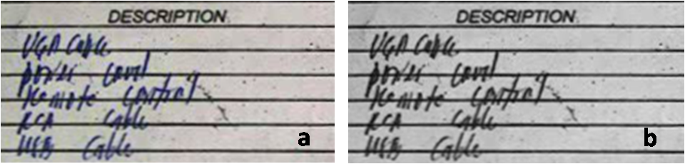
Preprocessing cont…
Greyscale Image

Slide 19



Preprocessing
Sobel
Edge Detection
Laplace
Canny

Slide 20
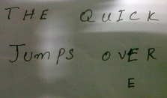
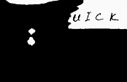
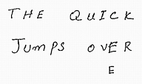
Preprocessing cont…
Binarization
Shadowy Image
Otsu (Global)
Adaptive ((local)

Slide 21


Preprocessing
Noise Removal

Slide 22
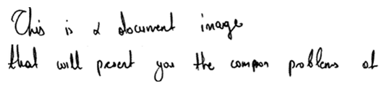



Segmentation cont…
External Segmentation
Region of Interest (ROI)
Line Segmentation
Word Segmentation

Slide 23

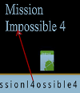
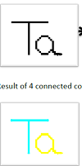
Segmentation cont…
Internal Segmentation
Vertical line test Segmentation
Connected Components
example

Slide 24
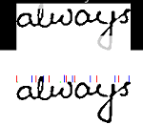
Segmentation cont…
Joining Writing segmentation using Base Line and Thickness of characters

Slide 25
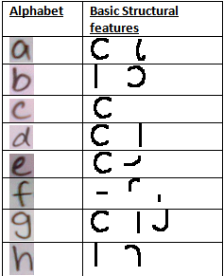
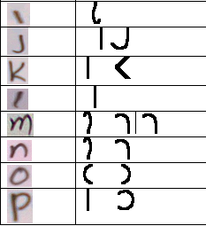
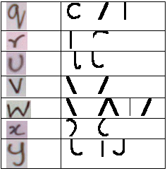
Feature Extraction
Structural Feature
Basic character shapes Analysis

Slide 26



Classification
Pixel by Pixel Matching
Failed to work with different writing styles!
1- 0 vector form
Q

Slide 27

Classification cont…
Basic Shape Matching
Selecting Best fit shapes using Data Structure

Slide 28
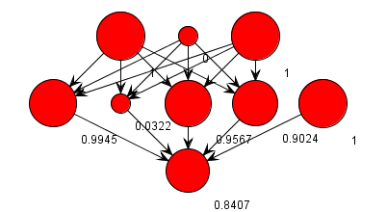
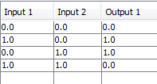
Classification cont…
Neural Networks
We used Multi Layer Perceptron
MLP Network
Training Data
Resu1t : 1 XOR 1= ZERO

Slide 29
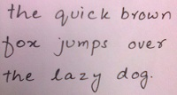




Classification cont…
Step1: Collecting Samples
Step2: Analysis and Cropping Samples

Slide 30



Classification cont…
Step3: Samples Analysis
Step4: Vectorize samples (Android)
Step5: Training (Java)
Step6:Using training file in OCR (Android)
NN(MLP)
Trained file.nnet

Slide 31
Post Processing
In post processing we improve image quality like, noise, text arrangement etc.

Slide 32
Results
We have trained the neural network with 17*62 = 1054 alphabet samples.
Tested the OCR on several trained samples and got 90% accuracy.
Tested the OCR on more than 80 un-trained samples and got 65% accuracy.

Slide 33
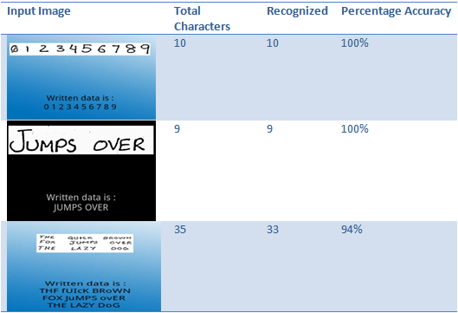
Results Trained (Discrete characters) cont..

Slide 34
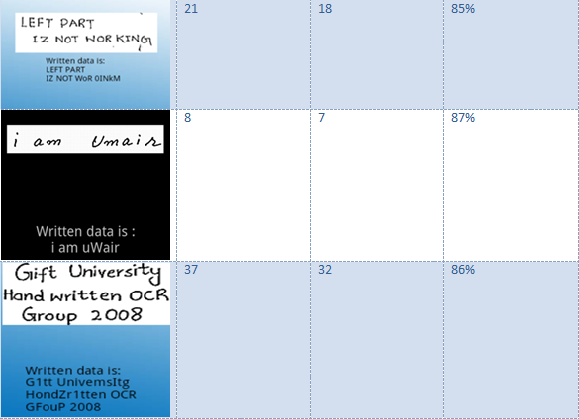
Results Un-Trained (Discrete characters) cont..

Slide 35
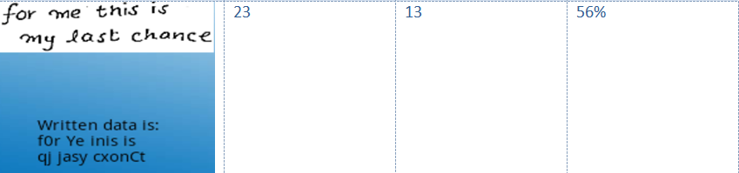
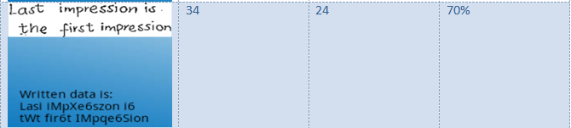
Results Un-Trained (Discrete characters)

Slide 36
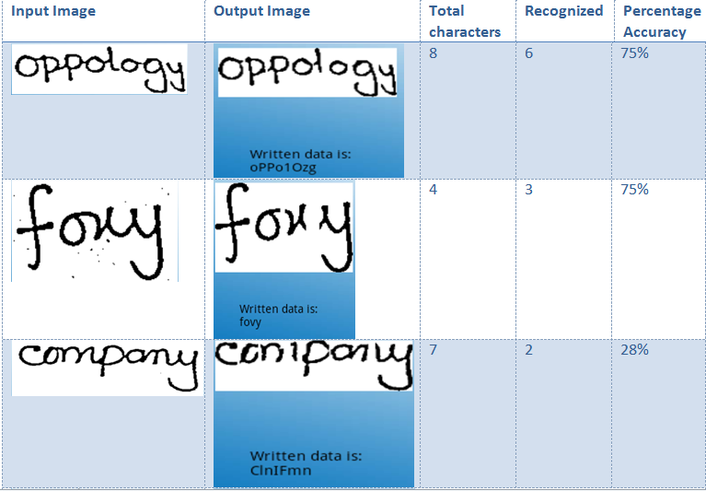
Results Un-Trained (Joining Words) cont..

Slide 37
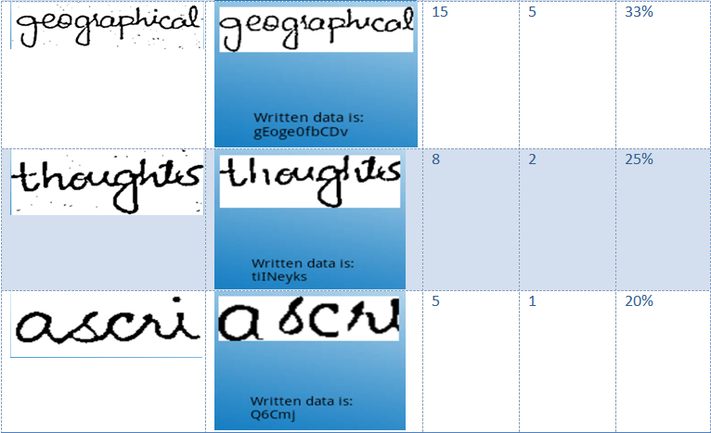
Results Un-Trained (Joining Words) cont..

Slide 38
Results Un-Trained (Joining Words) cont..

Slide 39
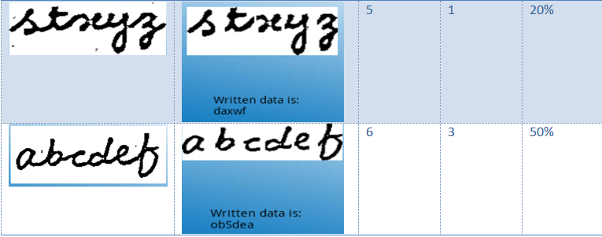
Results Un-Trained (Joining Words)

Slide 40
Demo

Slide 41
Conclusion
The Application recognizes English words and digits and display them on the screen with reasonable accuracy.
The accuracy can be increased by implementing spell checker and improved noise removal techniques in future.
The system can also be enhanced by adding more characters e.g. symbols, punctuation marks etc.

Slide 42
Thank You!

